Slide 1

Regularizing your neural network
Why regularization reduces overfitting
deeplearning.ai

Slide 2

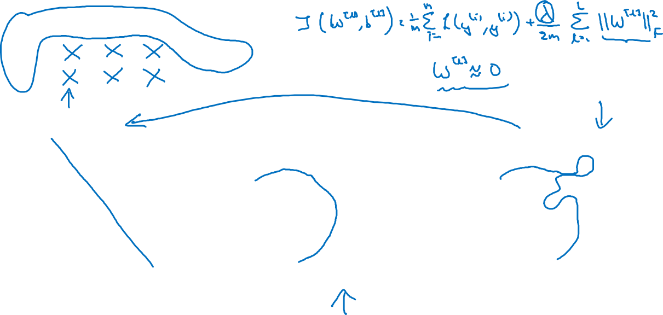



How does regularization prevent overfitting?
$$x_{1}$$
$$x_{2}$$
$$\hat{y}$$
$$x_{3}$$
high bias
“just right”
high variance

Slide 3
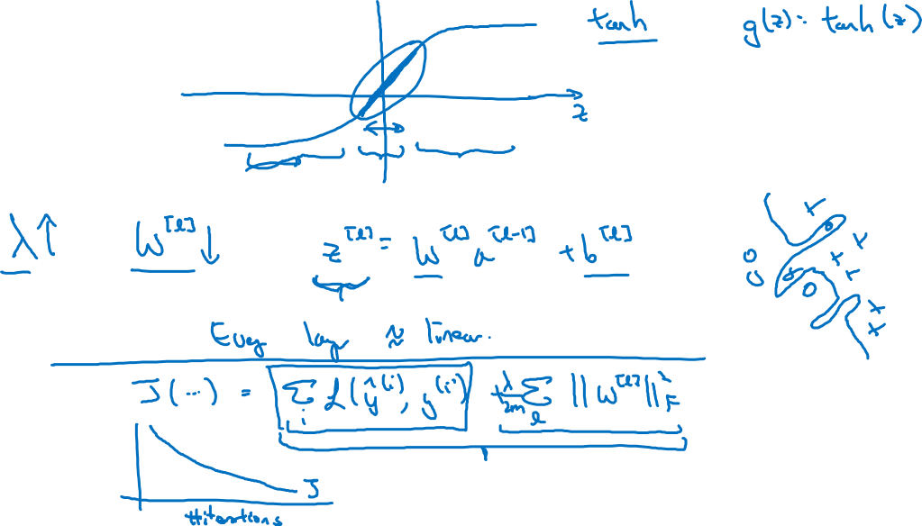
How does regularization prevent overfitting?

